Slide 1


ASSIGNMENT - 6
DONE BY: NISHITA BANKAPUR
COURSE : B.SC(HONS)DATA SCIENCE.
SUBMITTED TO: CVSN REDDY

Slide 2
Table Of Content
• What is Artificial Intelligence and Machine Learning
• What is Supervised, Unsupervised and Reinforcement Learning
• What is Regression and it’s types
• What is Classification and it’s types
• Explain Features , Labels and Model in Machine Learning

Slide 3

ARTIFICIAL INTELLIGENCE (AI)
Artificial intelligence is the intelligence demonstrated by the machine or computer , where human brain is put inside the machine or computer.

Slide 4
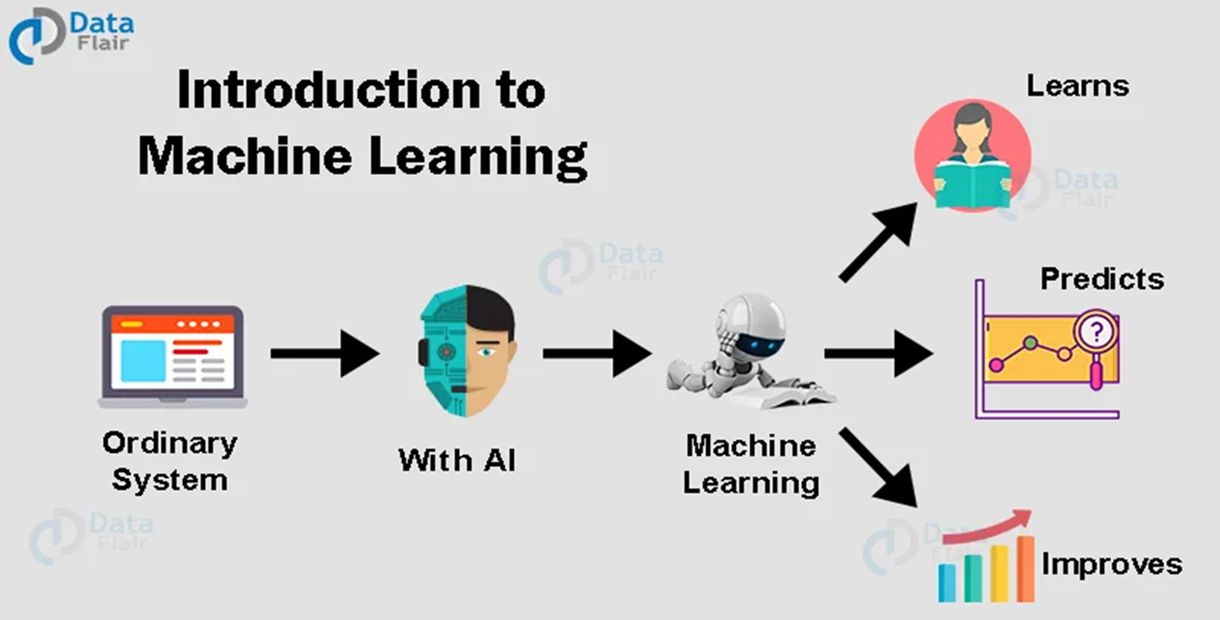
MACHINE LEARNING
Machine Learning is one of the most exciting subsets of
Artificial Intelligence.
It is the process of making the computer learn.
It is the process of giving input and output to the
machine , learning algorithm it will give a program.
It is used for predictive analytics means taking
data from the past and predicting the future.

Slide 5
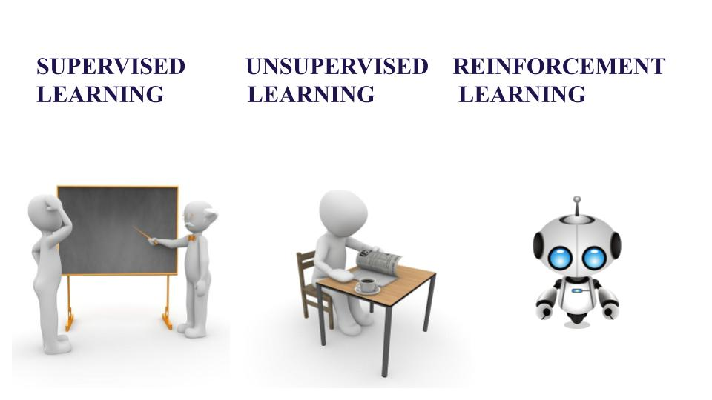
TYPES OF MACHINE LEARNING
Machine Learning Algorithms can be classified into 3
types as follows –
• Supervised Learning
• Unsupervised Learning
• Reinforcement Learning

Slide 6
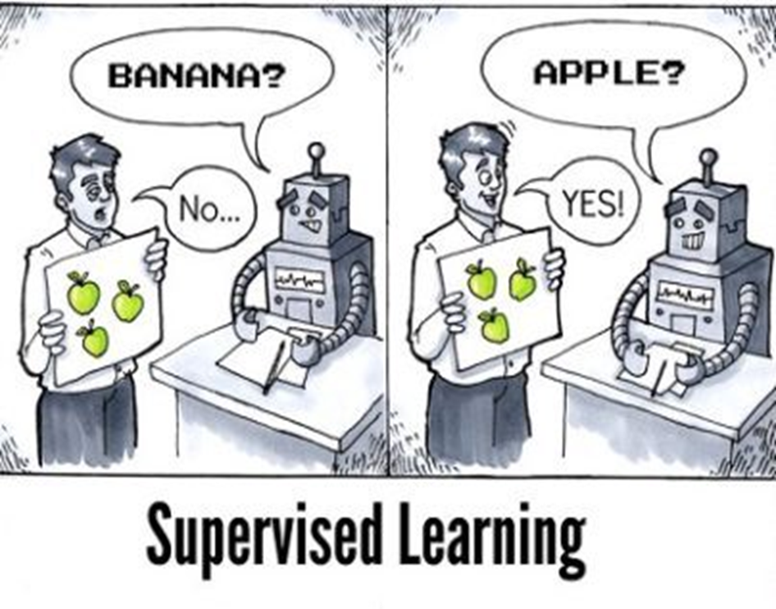
SUPERVISED LEARNING (S.L.)
Supervised Learning :-
• Learn from someone
• Will have features and labels
• Has two algorithms regression
and classification

Slide 7

UNSUPERVISED LEARNING(U.S.L)
2. Unsupervised Learning :-
• Learning on our own

Slide 8
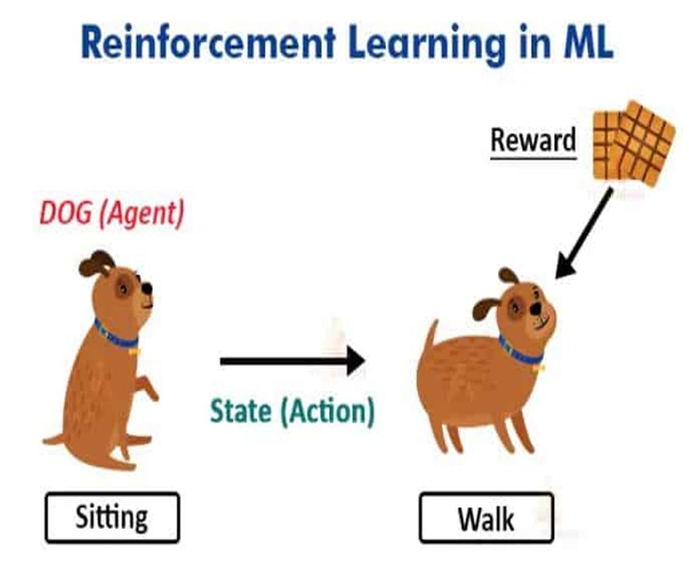
REINFORCEMENT LEARNING(R.L.)
3. Reinforcement Learning :-
• Rewards and Penalty
• For each good action, the agent gets
positive feedback, and for each bad action the agent gets negative feedback
or penalty.

Slide 9
MACHINE LEARNING ALGORITHMS IN S.L.
There are two machine learning algorithms in supervised learning. They are Regression and Classification.
1. Regression :- Data comes in continuous mode.
•In regression we use only:
•LINEAR REGRESSION
•NON LINEAR REGRESSION
2. Classification :- Data comes in discrete mode. Data may be in form of yes or no , true or false , male or female , boy or girl, pass or fail etc.

Slide 10
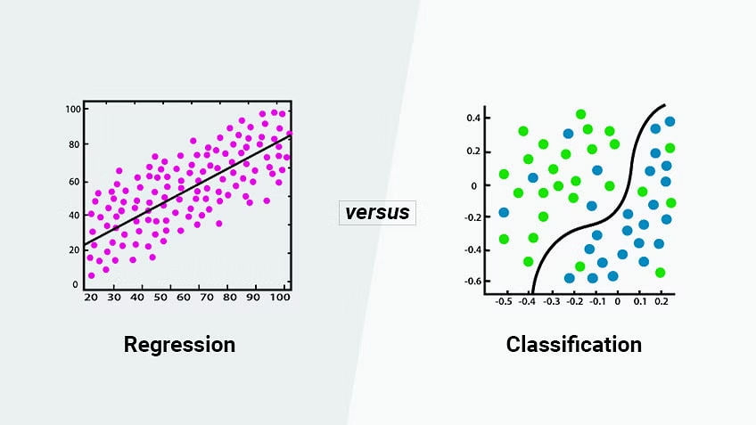
•In classification we use:
•LOGISTIC REGRESSION
•DECISION TREE
•RANDOM FOREST
•K NEAREST NEIGHBOUR [KNN]
•SUPPORT VECTOR MACHINE
[SVM]
•NAIVE BAYES

Slide 11
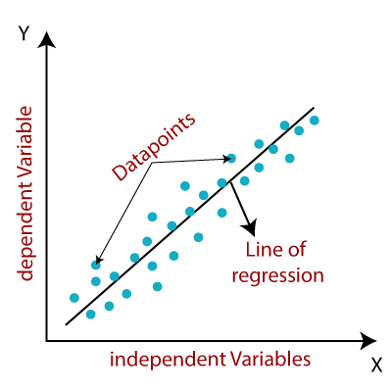
LINEAR REGRESSION
LINEAR REGRESSION is used to predict
the value of the variable based on the
value of the another variable.
∙It relates two variables (X and Y) with a straight line
(y = mx + b).

Slide 12
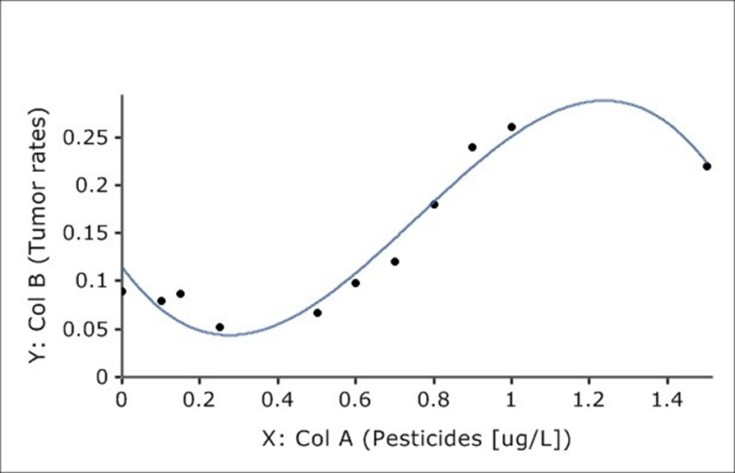
NON LINEAR REGRESSION
Non linear regression is a form of
regression analysis in which data is fit
to a model and then expressed as a
mathematical function.
∙It relates the two variables in a nonlinear (curved) relationship.(such as x^2 , x^3...).

Slide 13
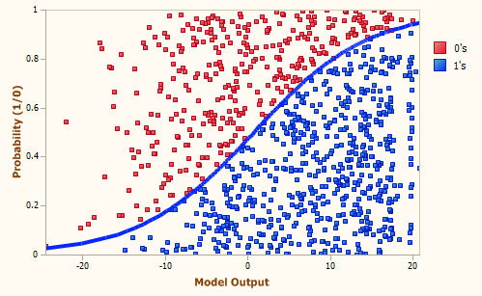
LOGISTIC REGRESSION
Logistic regression estimates the probability of an event occurring, such as voted or didn’t vote, yes or no, based on a given dataset of independent variables.

Slide 14
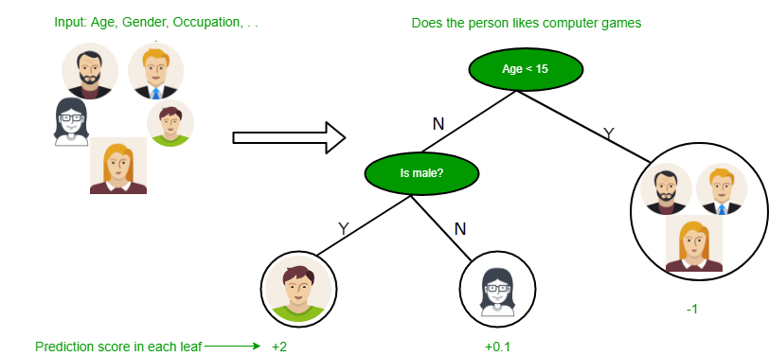
DECISION TREE
It belongs to supervised
learning algorithm and it
can be used in both regression
and classification.

Slide 15
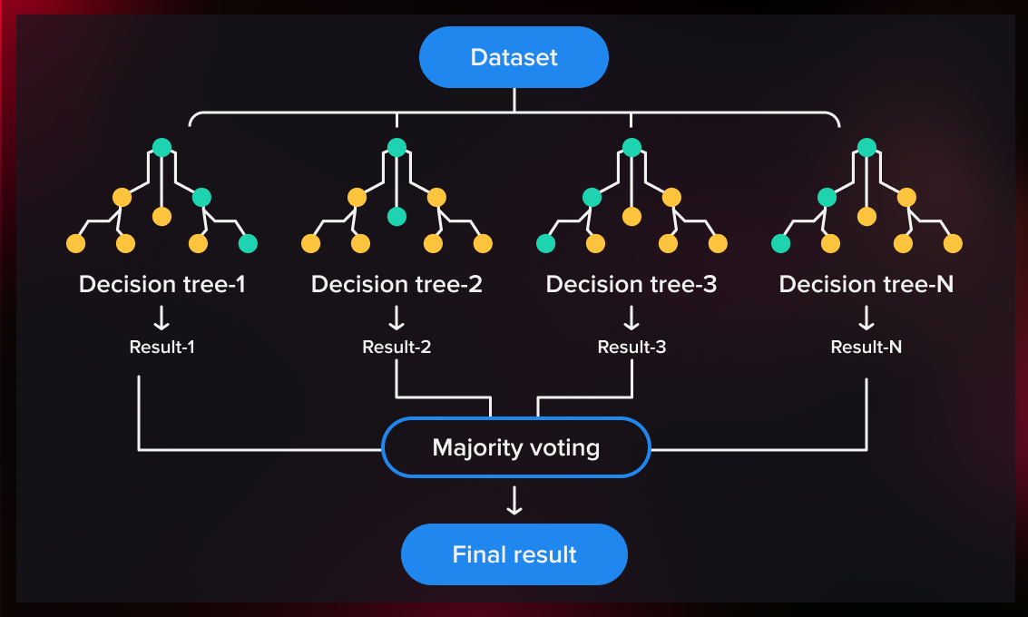
RANDOM FOREST

Slide 16
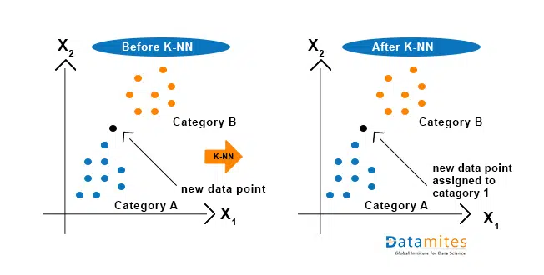
KNN(K Nearest Neighbour)

Slide 17
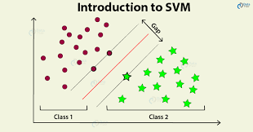
SUPPORT VECTOR MACHINE (S.V.M)

Slide 18
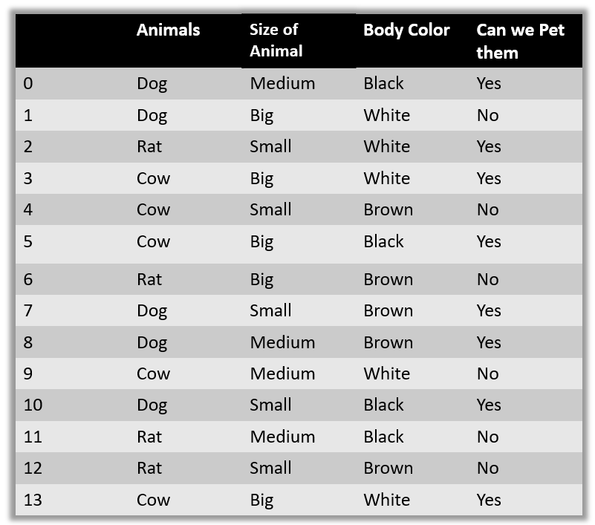
NAÏVE BAYES

Slide 19
FEATURES , LABELS AND MODEL IN M.L.
•X=1 F(x)=2
∙X=2 F(x)=4
∙X=3 F(x)=6
∙X=4 F(x)=8
∙What is X=6?
∙F(x)=2X
• Inputs are called Features.
• Outputs are called Labels.
• Functions are called Models.

Slide 20
THANK YOU

